Slide 1
IST 707 Final Project
Gabe Herz, Dan Beim, Pranjal Singh, Kabir Thakur, and Shane Halpin

Slide 2
Project Overview
For our project, we looked at mlb pitch and at-bat data from the 2015-2018 seasons
We used both Association Rules Mining and k-Means Clustering to solve multiple problems
Notes:
Shane

Slide 3
Data Overview
We used two data files for our project, both sourced from Kaggle
The pitches.csv file contained every single pitch thrown between the 2015 and 2018 seasons, adding up to around 2 million rows
The features of the dataset include physical data of the pitch, such as start speed, end speed, vertical break, horizontal break, spin rate, spin direction, and break length
The dataset also includes game specific data such as the count, number of outs, and dummy variables indicating if there were runners on base
The atbats.csv contains the outcome of each at-bat

Slide 4
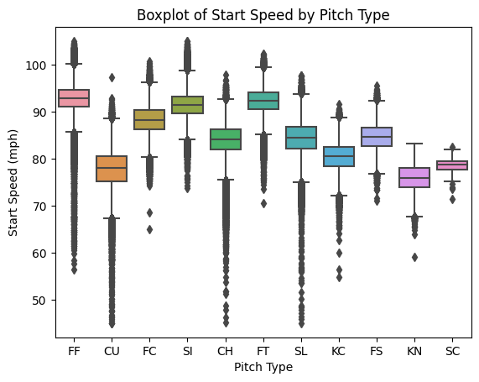
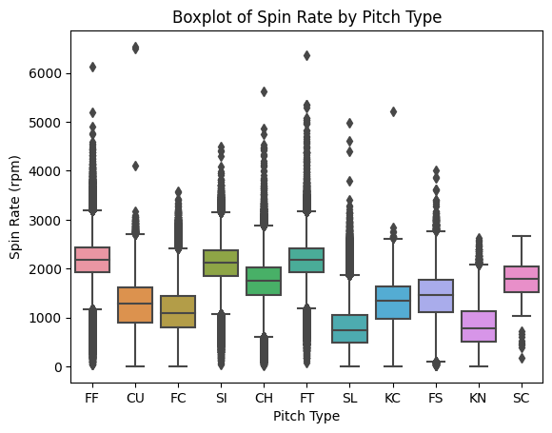
Boxplots by Pitch

Slide 5
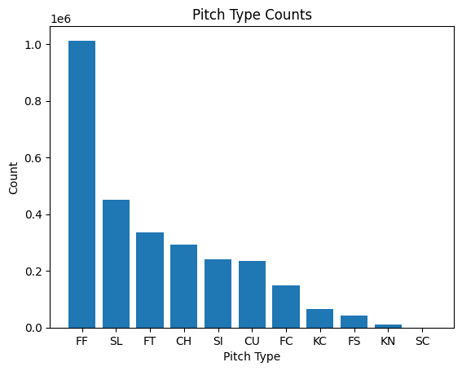
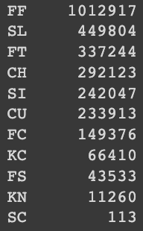
Pitch Type Counts

Slide 6
Association Rules Mining Overview
Pitch type association rules for game situation
Which pitches are most frequently thrown in various game scenarios?
Outcome association rules for pitch type
What physical properties of pitches lead to most optimal outcomes?
Individual analysis for fastballs and sliders

Slide 7
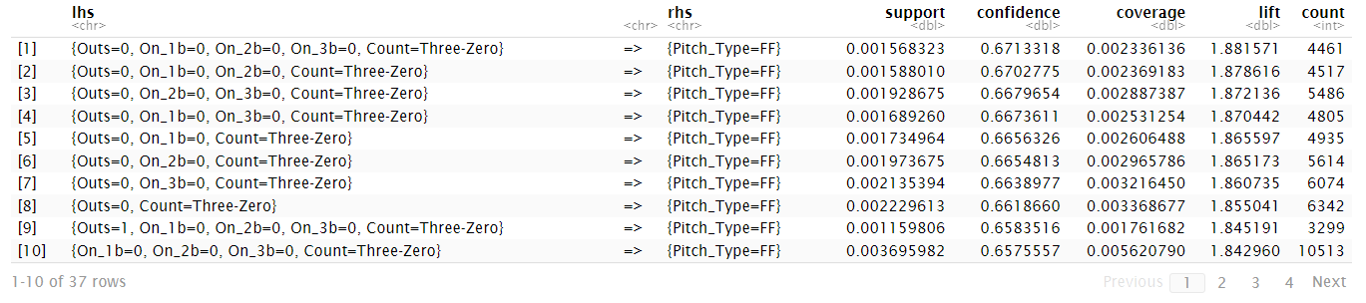
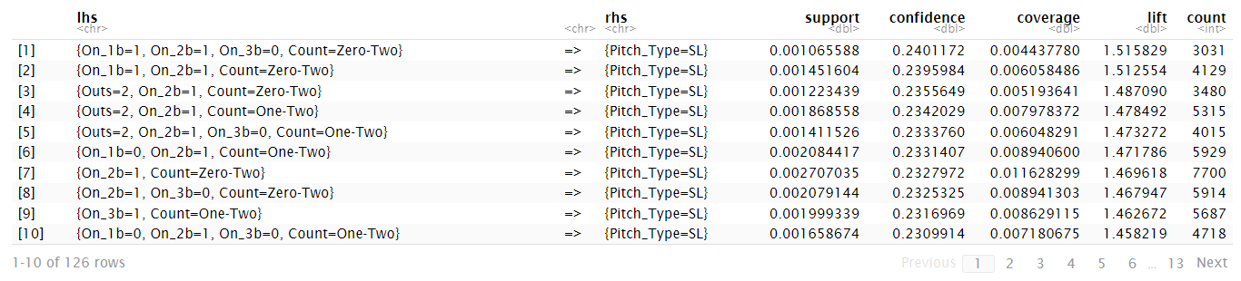
Pitch Type Association Rules For Game Situation
Different pitchers tend to vary pitch selection in each game situation = Not many strong pitch type associations with game scenarios that are in common for all pitchers
Extremely likely to throw a fastball in high ball counts (Three-Zero/ Three-One)
Extremely likely to throw a slider/breaking ball in high strike counts (Zero-Two/One-Two)

Slide 8
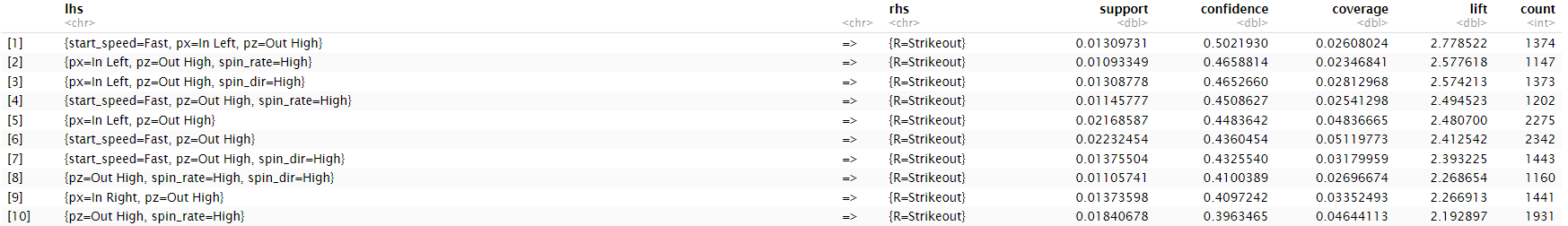
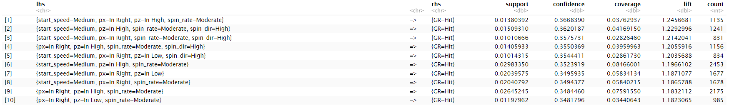
Outcome Association Rules For Fastballs
Fastballs are more likely to result in a strikeout when thrown high above the zone (left side of the zone for lefty hitters/right side of the zone for righty hitters)
“Fast” fastballs (above 93 MPH) are much more likely to result in a strikeout whereas lesser velocities thrown in the strike zone result in hits.
Lefty batters find greater success when fastballs are thrown inside (right side of the plate), whereas the opposite is true for righty batters.
Higher spin rates lead to more strikeouts whereas lower spin rates lead to hits

Slide 9
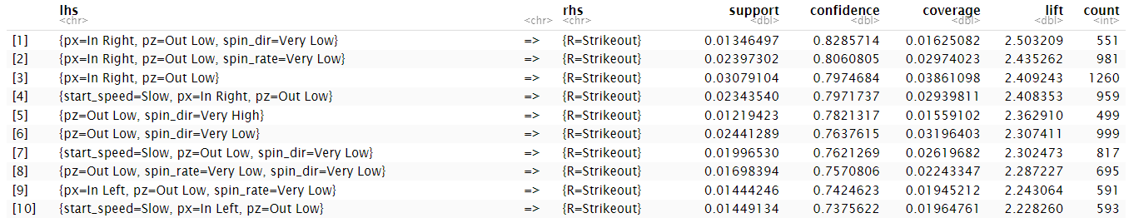
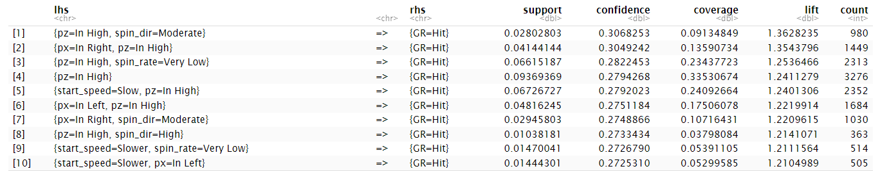
Outcome Association Rules For Sliders
Sliders typically result in strikeouts when they are thrown low below the strike zone and typically inside (Right side of the zone for lefty hitters and vise versa)
Sliders result in hits when they are thrown high in the strike zone
When the degree of spin increases from “Very Low” or “low” (0-150 degrees) to “moderate” or “high” (150-250 degrees) the slider is more likely to result in a hit opposed to a strikeout.

Slide 10
Pitcher Clustering
One of the largest responsibilities for a Major League Baseball team’s front office is to prepare game strategy on a daily basis.
With their being 30 teams across two leagues (National and American) as well as three divisions in each league (West, Central, East) most teams don’t play each other often.
By clustering pitchers by how they throw each pitch, teams can prepare for matchups against unfamiliar pitchers by comparing them with previously faced pitchers as well as assessing the relative strengths of their pitches.

Slide 11
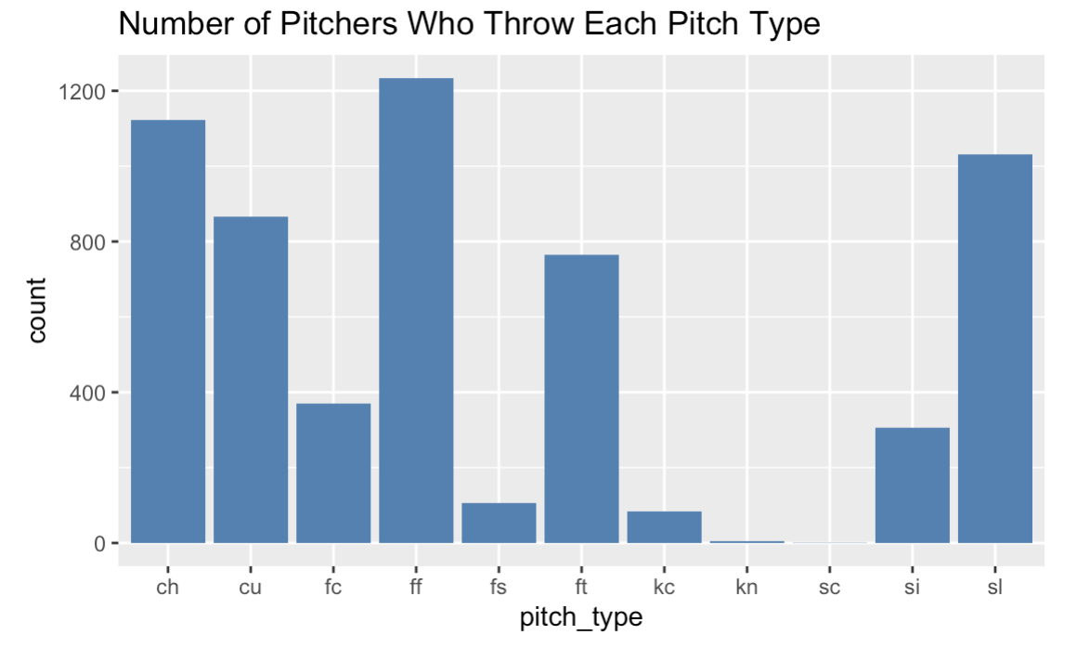
Pitch Type Breakdown
There were 11 pitch-types in the dataset. Clustering algorithms were run for nine of the 11 pitch-types, with the omission of the knuckleball and screwball.

Slide 12
Pitcher Clustering Methodology
The initial dataset was grouped by pitch_type and pitcher_id and the means of each metric were taken. In doing so, we created sub datasets for each pitch-type with the average metrics of all pitches each pitcher threw of that type over the sample.
Adequate clusters were found for seven of the nine pitches. We were unable to create relevant clusters for both Curveball and Cutters.

Slide 13
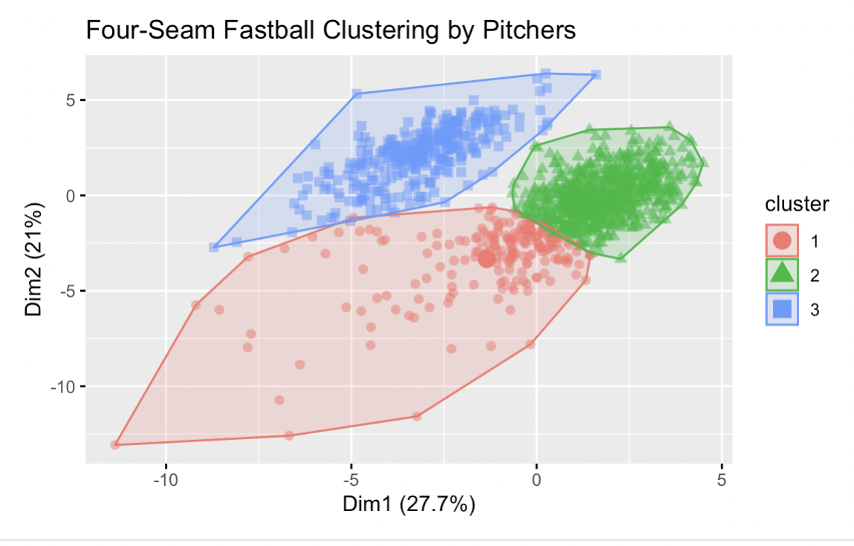
Four-Seam Fastball Clustering
The most common pitch thrown, 1,234 pitchers in the sample had thrown a four-seamer. The cluster analysis separates pitchers into three types of four-seam fastball throwers.
Cluster 1 is associated with slower pitches with less spin.
Cluster 2 is associated with the fastest pitches, most spin, and vertical movement
Cluster 3 is associated with average velocity and spin, but the most horizontal movement

Slide 14
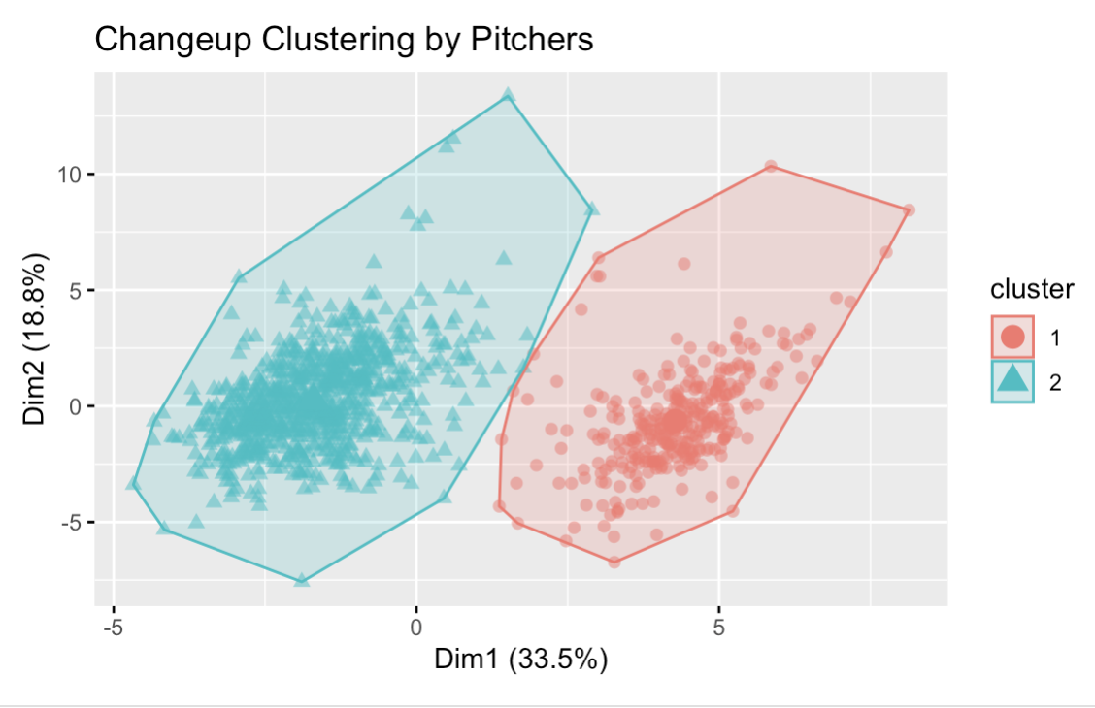
Changeup Clustering
1,122 pitchers in the sample threw a changeup
Changeups are intended to be thrown at the same perception as a fastball, but come in slower. Typically, the larger difference in your fastball/changeup velocities, the better.
Cluster 1 is associated with slower changeups with greater horizontal and vertical break.

Slide 15
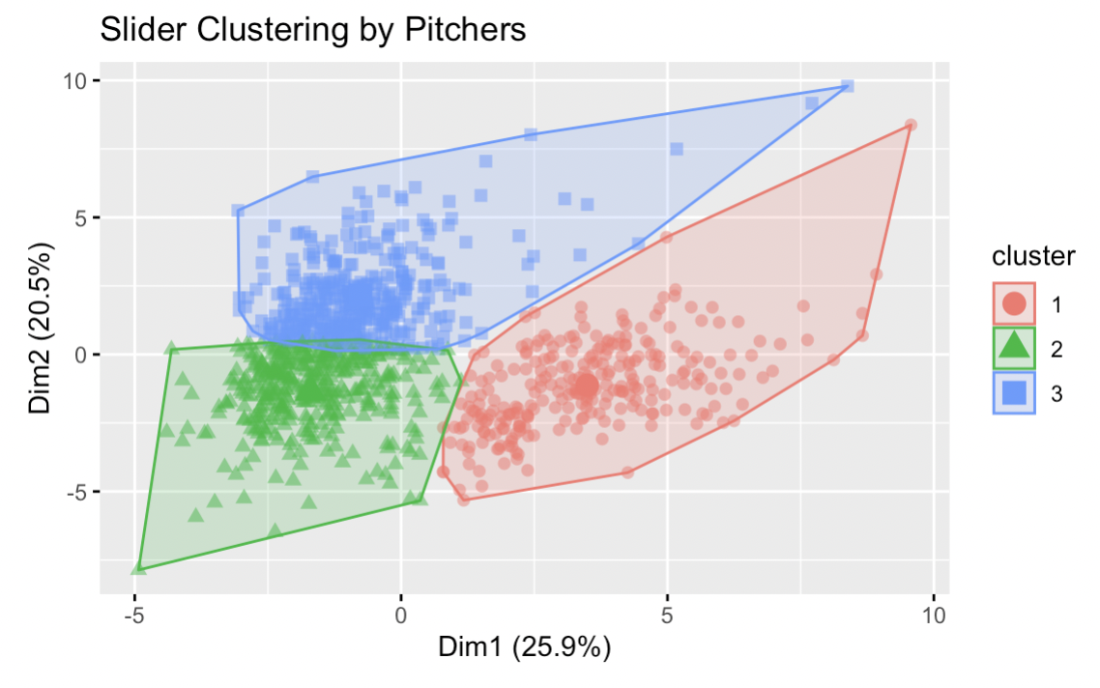
Slider Clustering
Ideally, a slider maximizes horizontal movement. Velocity is important in the absence of movement.
Cluster 1 is associated with the least velocity and movement. Cluster 2 is associated with the fastest, highest spin sliders, with the most vertical movement. Cluster 3 is associated with sliders with the most horizontal movement

Slide 16
Conclusion
The findings of our project provide helpful insights for Major League Baseball teams
The takeaways from AR Mining helps teams identify what pitches to throw to maximize outs, as well as helping the hitters prepare for what pitches they are likely to see in specific scenarios
The takeaways from the Clustering helps teams bucket opposing pitchers into various skill categories, helping them better prepare for upcoming matchups

